Slide 1
Mitigating IoT-based Cyberattacks on the Smart Grid
Suleyman Uludag
Department of Computer Science
University of Michigan, Flint, MI
Yasin Yilmaz, Mahsa Mozaffari
Secure and Intelligent Systems Lab
sis.eng.usf.edu
Department of Electrical Engineering
University of South Florida, Tampa, FL

Slide 2
Outline
What is Smart Grid?
Cybersecurity in the Smart Grid
IoT-based Cyberattacks to the Smart Grid
MIAMI-DIL framework
Simulation results

Slide 3
What is Smart grid?
Smart Grid
Information technology
Communication technology
Advanced Computing
Power Technology
Existing power systems
Next generation power system
Need for:
More reliable
More efficient
More Secure
Greener
Enables two-way data communication
Real-time monitoring of smart grid
Data collection purposes
Notes:
Next generation
Goal is to make delivering of the electricity from generation to the consumers more efficient, reliable, secure and more environmental friendly
Smart grid is the Integration of advanced computing and information and digital communication systems, power technologies with the existing power systems.
Some Advantages :
Another Advantage : easy integration of renewable energy sources
Smart grid enables real time data and consequently real time decision making such as real time pricing
Another advantage is timely detection of failures and troubleshooting
In the current electric grid if outage occurs, CC won’t know unless consumers call and notify them. But in the smart grid, thanks to real time monitoring of the entire system, CC can immediately be notified of power outage in the system.
These were some of the advantages that smart grid brings to the electricity delivery system.
On the other hand, putting the gri

Slide 4
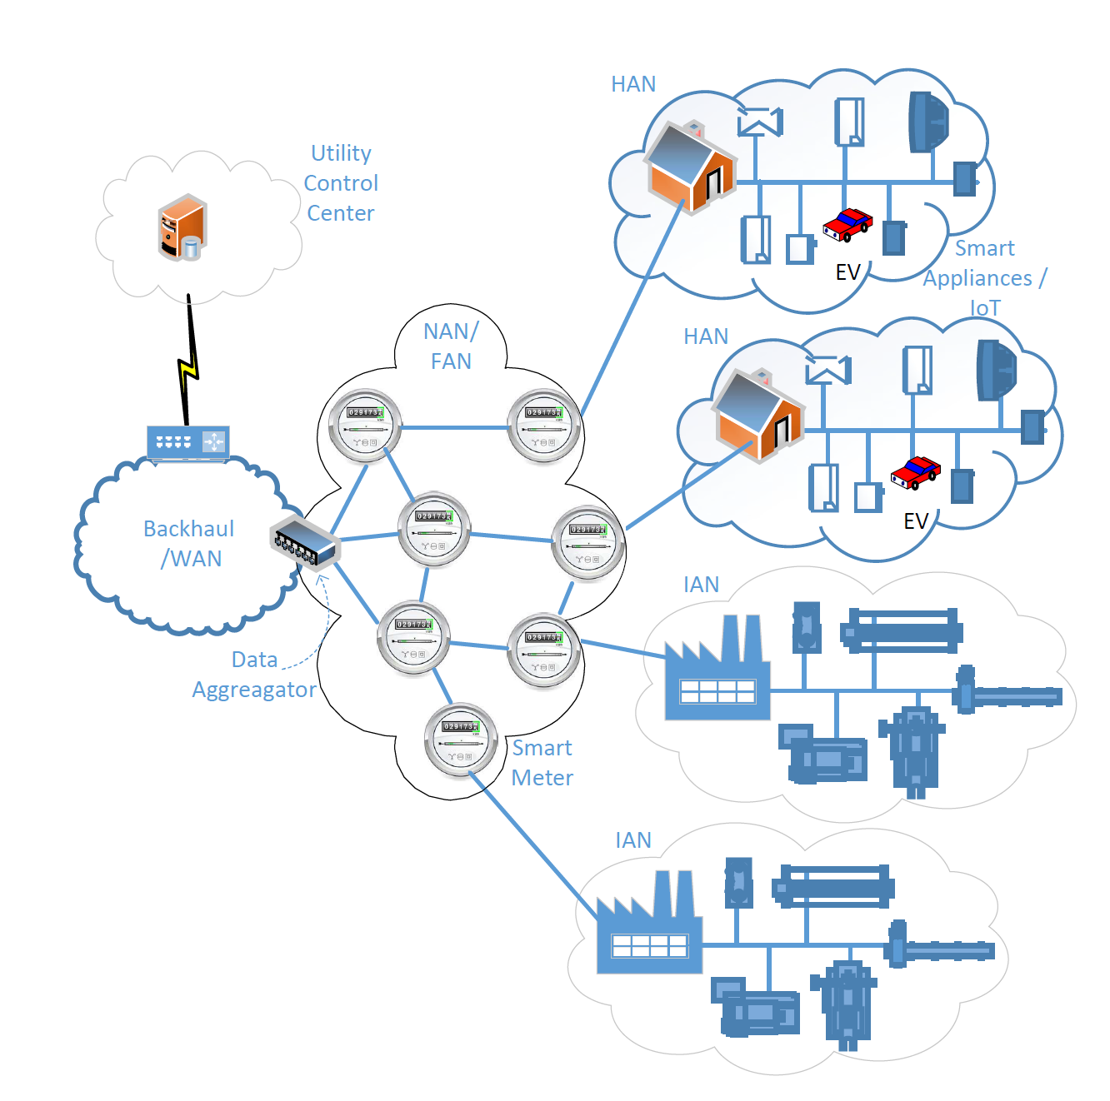
Smart grid model
$$CC$$
$$z_{t}^{1}$$
$$z_{t}^{i}$$
$$z_{t}^{N}$$
$$DA 1$$
$$DA i$$
$$DA N$$
$$y_{t}^{i1}$$
$$y_{t}^{ij}$$
$$y_{t}^{iJ}$$
$$SM 1$$
$$SM j$$
$$SM J$$
$$x_{t}^{ij1}$$
$$x_{t}^{ijk}$$
$$x_{t}^{ijK}$$
$$SA 1$$
$$SA k$$
$$SA K$$
Notes:
Big Picture:
Smart Grid is closely connected to the other technologies such as smart home, smart city, electrical vehicles
Appliances in a smart home are connected to the grid through smart meters, so IoT devices and smart appliances which are in daily use of people are directly connected to the smart grid by the means of smart meters
This increases the security vulnerabilities in the smart grid for the security level of these devices as usually not sufficient and they can cause threats to it
One of the IoT devices connected to the grid can be EV/autonomous cars
Smart city is also a part of the grid
All these technologies are related and so vulnerabilities in these technologies are threats to the smart grid
Putting the System in the cyber brings the possibility of attack same as the many other cyber related technologies.
So these vulnerabilities should be addressed in the smart grid.

Slide 5
Cybersecurity in smart grid
Availability
Reliable access to Information: DoS attacks
Integrity
Ensure information authenticity: False data Injection
Confidentiality
Protect personal privacy
Notes:
Three high level cybersecurity objectives: Availability, Integrity, Confidentiality

Slide 6
Iot-triggered threats
Smart Grid connected to huge number of IoT devices through smart meters
Low security level in simple IoT devices
New Genre of attack vectors : IoT-triggered attacks
An example :
Mirai Botnet
Victim
Attacker
server¹

Slide 7
Security challenges in smart grid
High dimensionality
Quick Detection
Uncertainty
Dynamicity
Mitigation methods should address these challenges
Notes:
How do we address these security challenges in the proposed method
Why Dimensionality is high? Monitoring the grid as a whole is very important, because some scaled attacks may be designed in a way that the magnitude of attacks may bypass local filters and without network wide monitoring they can bypass the whole system, but the aggregate impact of small attacks may be significant.
Therefore, it’s important to monitor the whole network, so that the small attacks, and statistics come together and we can detect.
That makes the dimensionality challenge, because we consider the whole network and that mean a huge number of devices
Dynamicity : Power system is itself dynamic, its state changes, uncertainty : there is a lot of unknowns
Quick detection : due to critical nature of the smart grid and the damaging impacts of a successful attack to it, the attacks need to be detected and eliminated very quickly, before harming the system. Therefore real time monitoring of the system is of high importance. Also, it’s important to have computationally efficient approach since heavy computation can prevent real-time monitoring

Slide 8
Related works
Specification based IDS¹
Configuration based IDS²
Anomaly Detection on Encrypted Traffic³
Randomization based IDS⁴
Distributed IDS in a multi-layer network architecture of smart grid⁵
Real time anomaly based IDS utilizing stream data mining⁶
Notes:
Specification based Intrusion detection system for advanced metering infrastructure: solution to prevent compromised devices from impacting the stability of the grid and the reliability of the energy distribution infrastructure
Monitors traffic and application layer protocol of ANSI C12.22 to identify violations of specified security policy
Doesn’t considers other protocols which are used in industry
Configuration based IDS
a novel device configuration based stochastic model checking intrusion detection technique
Forth order markov chain based model
Anomaly Detection on Encrypted Traffic
Distributed IDS in a multi-layer network architecture of smart grids
Designed for specific wireless mesh network technology assumptions
Real time anomaly based IDS utilizing stream data mining
Can only be deployed at head-end and the data aggregators due to its computational complexity
Quickest detection of false data injection attack in wide-area smart grids
Parametric
Conclusion : the existing techniques don’t address all of the following challenges

Slide 9
The mitigation Approach
MIAMI-DIL:
Minimally invasive attack Mitigation via detection, isolation, localization

Slide 10
MIAMI-DIL Framework
Detection of Anomaly
Isolation
Localization
Real-time detection by ODIT
Notes:
A picture of mitigation approach
Give an overview
Real-time non-parametric detection by ODIT

Slide 11
Underpinning anomaly detection algorithm: Online Discrepancy Test (ODIT)
Timely and Accurate detection of CUSUM
Simplicity of GEM approach^{1,2}
ODIT
Online
Non-parametric
Notes:
CUSUM : Cumulative Sum
GEM approach : Geometric Entropy Minimization for Anomaly detection
ODIT : Online Discrepancy Test
GEM : not online, fix sample size approach
CUSUM : well known online change detection algorithm -> parametric, needs known probabilistic distribution or estimate it -> in smart grid problem because of high dimensionality and high uncertainty it is intractable to estimate probabilistic distribution
Motivation for ODIT :
CUSUM is missing the practicality for high dimensional problem and we want sth non-parametric and simple -> efficiently in high dimensional
GEM effective with high dimensional data but it is not online

Slide 12
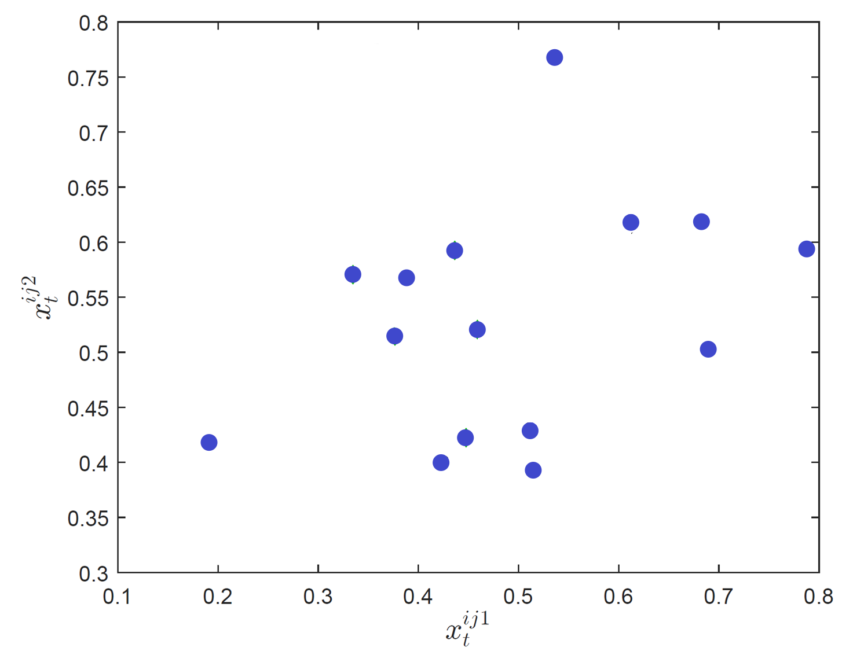
Odit: Training
Training set $X=\left\{X_{1},X_{2},…,X_{N}\right\}$ of non-attack data

Slide 13
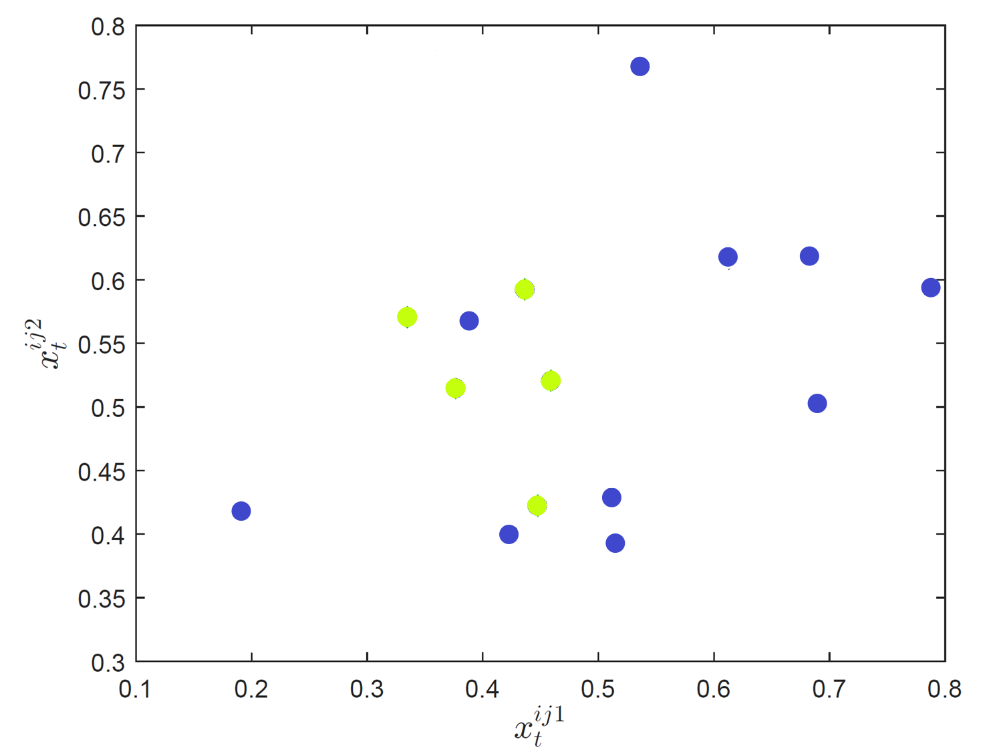
Odit: Training
Training set $X=\left\{X_{1},X_{2},…,X_{N}\right\}$ of non-attack data
Randomly separates into two sets $X^{N_{1}},X^{N_{2}}$

Slide 14
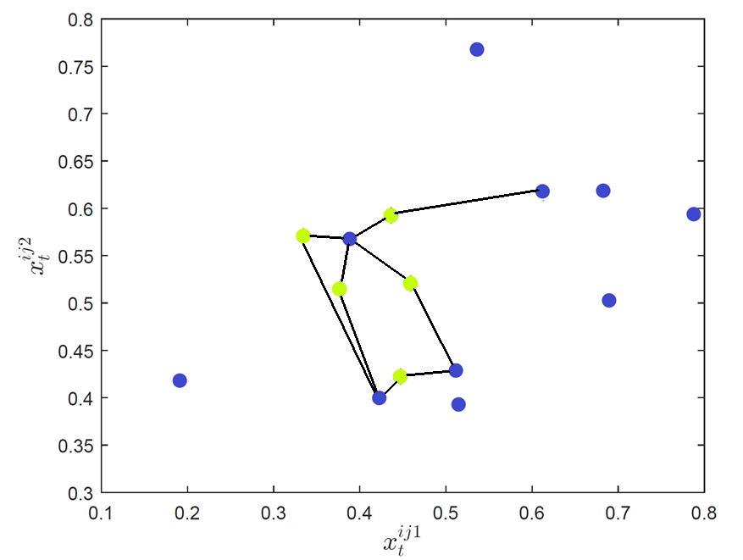
Odit: Training
Training set $X=\left\{X_{1},X_{2},…,X_{N}\right\}$ of non-attack data
Randomly separates into two sets $X^{N_{1}},X^{N_{2}}$
for each point in $X^{N_{1}}$find kNN from $X^{N_{2}}$

Slide 15
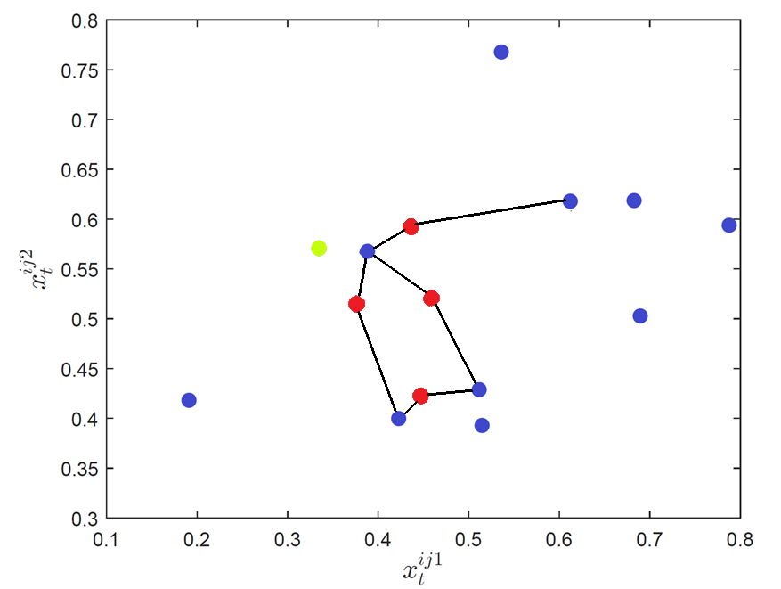
Odit: Training
Training set $X=\left\{X_{1},X_{2},…,X_{N}\right\}$ of non-attack data
Randomly separates into two sets $X^{N_{1}},X^{N_{2}}$
for each point in $X^{N_{1}}$find kNN from $X^{N_{2}}$
Select M points $X_{M}^{N_{1}}$ from $X^{N_{1}}$ with the smallest total edge length
$L_{M}$ = Mth smallest total edge length
$$L_{M}$$

Slide 16
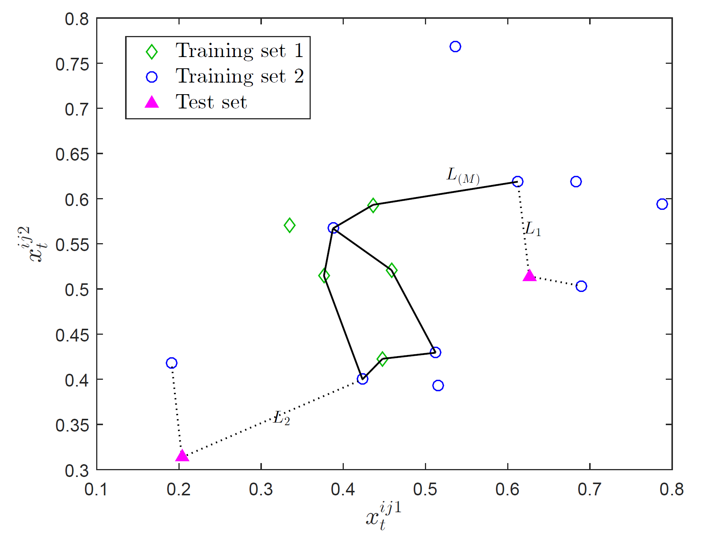
Odit: Test
For each test point $x_{t}$ find total edge length to kNN from $X^{N_{2}}$
$D_{t}= {L_{t}−L}_{M}$ : positive/negative evidence for anomaly

Slide 17
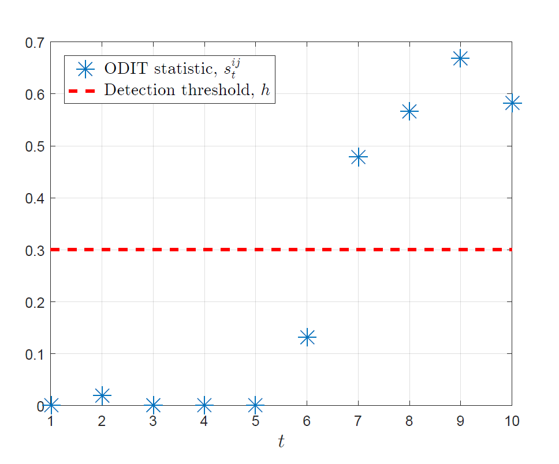
Odit: Test
For each test point $x_{t}$ find total edge length to kNN from $X^{N_{2}}$
$D_{t}= {L_{t}−L}_{M}$ : positive/negative evidence for anomaly
Accumulate anomaly evidences over time
$$s_{t}^{ij}=\max\left\{s_{t−1}^{ij}+D_{t} , 0\right\},s_{0}^{ij}=0$$
Declare anomaly when evidence exceeds threshold
$$T_{d}=min⁡\{t: s_{t}^{ij} ≥h\}$$
Threshold selected to strike a balance between early detection and small false alarm rate

Slide 18
System-wide ids
Hierarchical and distributed IDS
Each level monitors the lower level and computes a statistic
Statistics propagate upwards
$v_{t}$, $u_{t},s_{t}$: anomaly evidences at different levels of hierarchy
3 ODITs run
$$T_{s}=\min\left\{t: s_{t} ≥h_{s}\right\}$$
$$T_{u}=\min\left\{t: u_{t} ≥h_{u}\right\}$$
$$T_{v}=min⁡\{t: v_{t} ≥h_{v}\}$$
Anomaly declared when one alarms
$$T_{d}=\min\left\{T_{s},T_{u},T_{v}\right\}$$
$v_{t}$, $u_{t},s_{t}$
$$CC$$
$$z_{t}^{1}$$
$$z_{t}^{i}$$
$$z_{t}^{N}$$
$u_{t}^{i}$, $s_{t}^{i}$
$$DA 1$$
$$DA i$$
$$DA N$$
$$y_{t}^{i1}$$
$$s_{t}^{i1}$$
$$y_{t}^{ij}$$
$$s_{t}^{ij}$$
$$y_{t}^{iJ}$$
$$s_{t}^{iJ}$$
$$SM 1$$
$$SM j$$
$$SM J$$
$$x_{t}^{ij1}$$
$$x_{t}^{ijk}$$
$$x_{t}^{ijK}$$
$$SA 1$$
$$SA k$$
$$SA K$$

Slide 19
Isolation and localization of anomaly
Detection of Anomaly
Isolation
Localization
Real-time detection by ODIT
Temporary isolation of the suspected DAs

Slide 20
Isolation and localization of anomaly
Detection of Anomaly
Isolation
Localization
Real-time detection by ODIT
Temporary isolation of the suspected DAs
Detailed investigation of suspected nodes

Slide 21
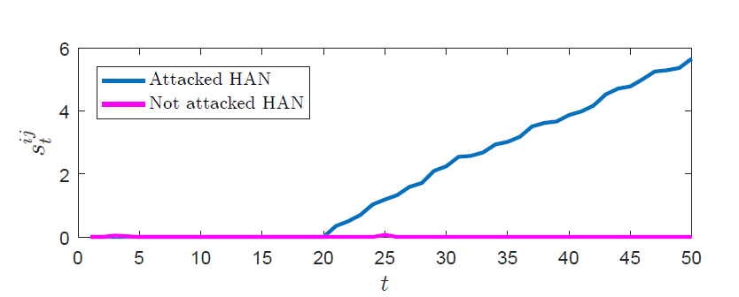
an Attack scenario
One million IoT devices
Attack in 10% of HANs
Attack starts at time 20
SM statistics start increasing in the attacked HANs

Slide 22
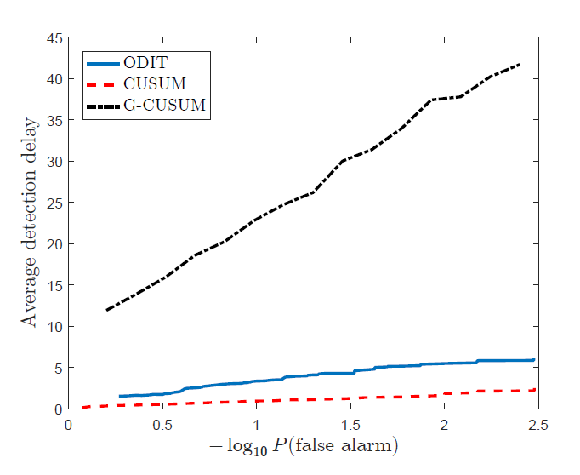
Odit vs. cusum false data injection attack
CUSUM, like an oracle, knows the actual distribution of baseline N(0.5, 0.01) and attack data N(0.5+0.2, 0.01)
G-CUSUM estimates the baseline parameters with %1 error
ODIT achieves a close performance to the oracle CUSUM
Notes:
It shows how a small amount of mismatch in the estimated parameters can result in significant degradation of G-CUSUM compared to CUSUM which has correct knowledge about data, and is in fact non-practical

Slide 23
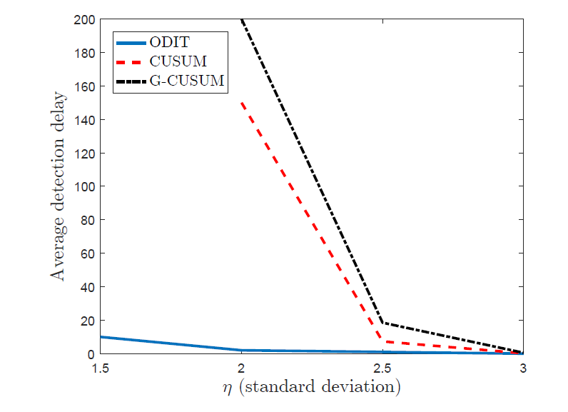
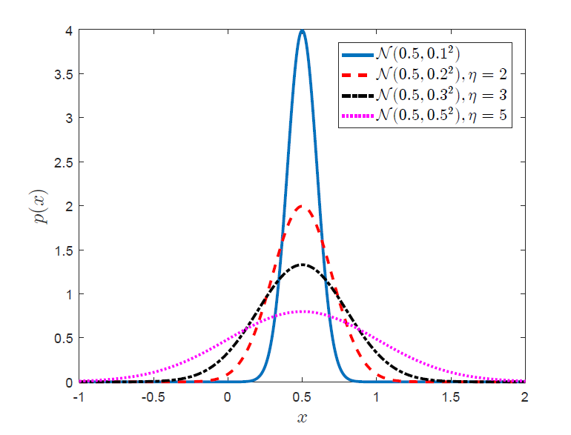
Odit vs. cusum jamming-type Dos attack
Attack data N(0.5, (η 0.1)²)

Slide 24
conclusion
With the proliferation of IoT devices and vulnerabilities associated with them, there is an increasing need to cope with IoT-based attacks
MIAMI-DIL framework is proposed as an Intrusion Detection System in Smart Grid
Scalable
Online
Non-parametric
Protocol-agnostic & free from any data type assumptions
ODIT is capable of timely and accurately detecting attacks

Slide 25
Thank you

